Slide 1
Recycler View and Adapter
Session 5
Course : Mobile Community Solution
Effective Period : September 2019

Slide 2
Learning Objectives
At the end of this meeting is expected that students will be able to:
  <LO>

Slide 3

Contents
Recycler View
Recycler View Components
Implementing Recycler View

Slide 4
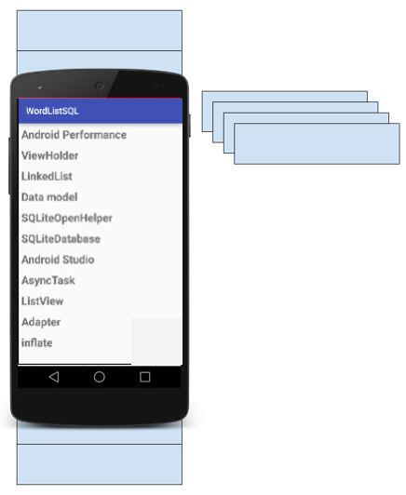
Introduction
RecyclerView is a scrollable container for large data sets
Efficient
  Uses and reuses limited number of View elements
  Updates changing data fast

Slide 5
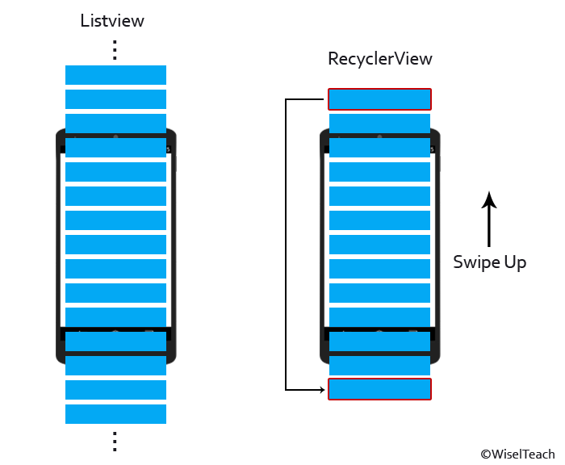
Introduction
As a recycler view is more flexible than a list view, it takes a lot more setting up.
Like list views, recycler views efficiently manage a small number of views to give the appearance of a large collection of views that extend beyond the screen.

Slide 6
Recycler View Components
Data
RecyclerView scrolling list for list items – RecyclerView
Layout for one item of data – XML file
Layout manager handles the organization of UI components in a View – RecyclerView.LayoutManager
Adapter connects data to the RecyclerView-RecyclerView.Adapter
ViewHolder has view information for displaying one item – RecyclerView.ViewHolder

Slide 7
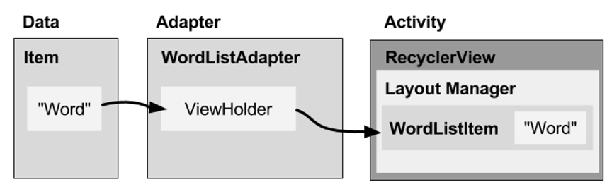
How Component fits together
A recycler view accesses its data using an adapter.
Adapter is not Android built-in, you have to write an adapter of your own that’s tailored to your data, including specifying the type of data, creating views, and binding data to the views.
Items are positioned in a recycler view using a layout manager.

Slide 8
What is a Layout Manager?
Each ViewGroup has a layout manager.
Use to position View items inside a RecyclerView
Reuses View items that are no longer visible to the user.
Built-in Layout Manager
  LinearLayoutManager
  GridLayoutManager
  StaggeredGridLayoutManager
Extend RecyclerView.LayoutManager

Slide 9
What is an Adapter?
Helps incompatible interfaces work together
  Example: Takes data from database Cursor and prepares strings to put into a View
Intermediary between data and View
Manages creating, updating, adding, deleting View items as underlying data changes.
RecyclerView.Adapter

Slide 10
What is ViewHolder?
Used by the adapter to prepare one View with data for one list item.
Layout specified in an XML resource file.
Can have clickable elements
Is placed by the layout manager
RecyclerView.ViewHolder

Slide 11
Implementation Steps
Step Summary
Add RecyclerView dependency to build.gradle if needed
Add RecyclerView to layout
Create XML layout for item
Extend RecyclerView.Adapter
Extend RecyclerView.ViewHolder
In Activity onCreate(), create RecyclerView with adapter and layout manager

Slide 12
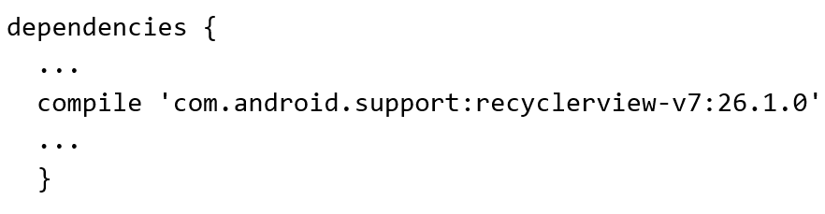
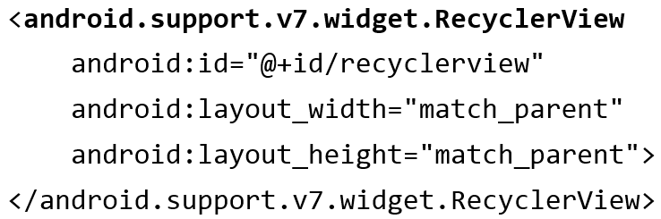
Implementation Steps
Add RecycleView dependency to build.gradle if needed:
Add RecyclerView to XML Layout

Slide 13
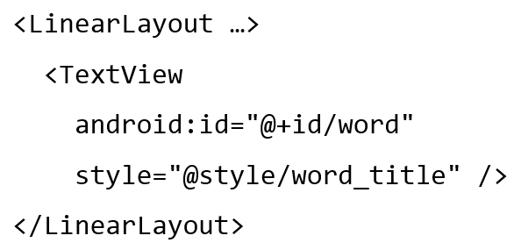
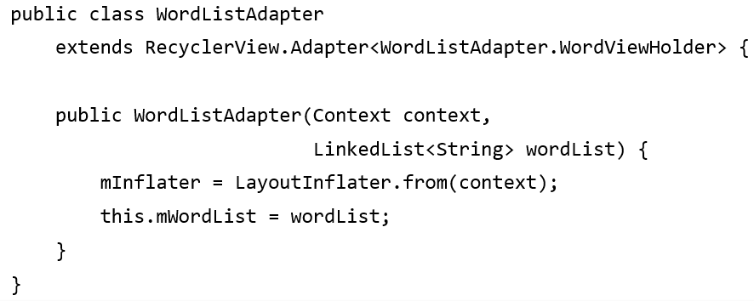
Implementation Steps
Create layout for 1 item
Implement the adapter

Slide 14
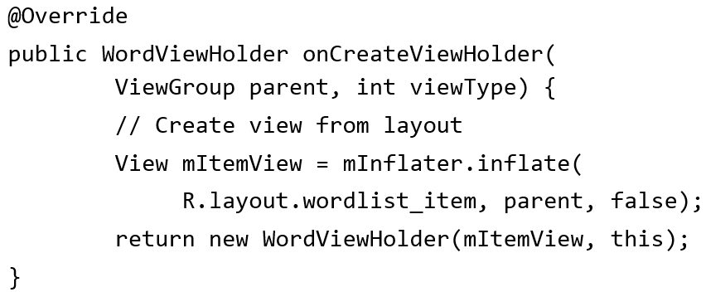
Implementation Steps
Adapter has 3 required methods:
  onCreateViewHolder()
  inBindViewHolder()
  getItemCount()
onCreateViewHolder()

Slide 15
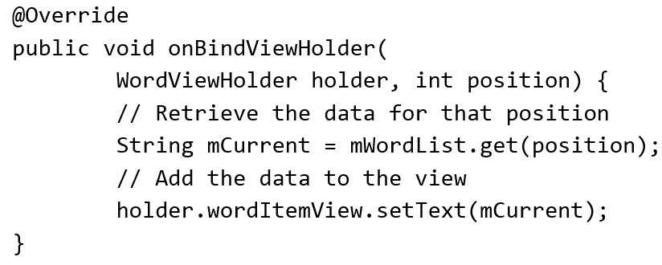
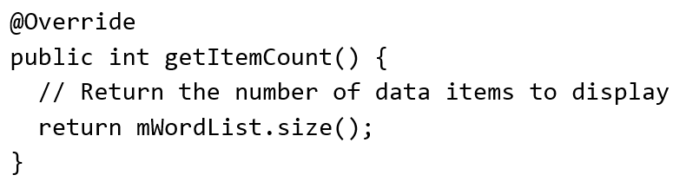
Implementation Steps
onBindViewHolder()
getItemCount()

Slide 16
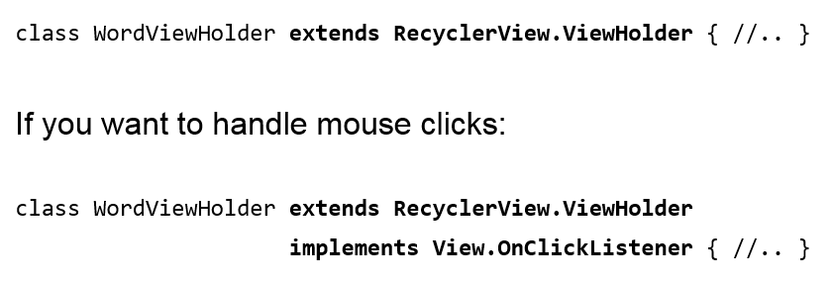
Implementation Steps
Create the view holder in adapter

Slide 17
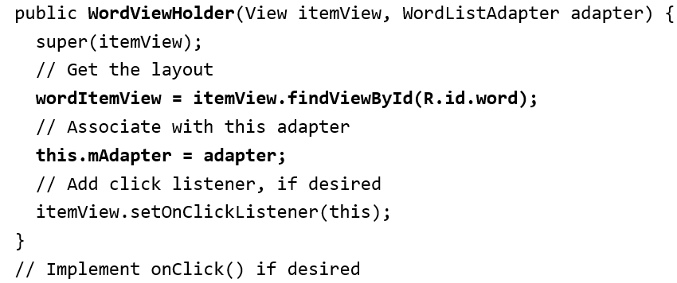
Implementation Steps
View holder Constructor

Slide 18
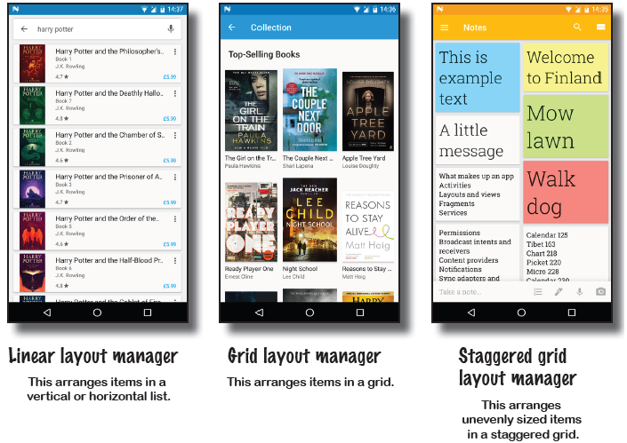
Implementation Steps
Create the RecyclerView in Activity onCreate()

Slide 19
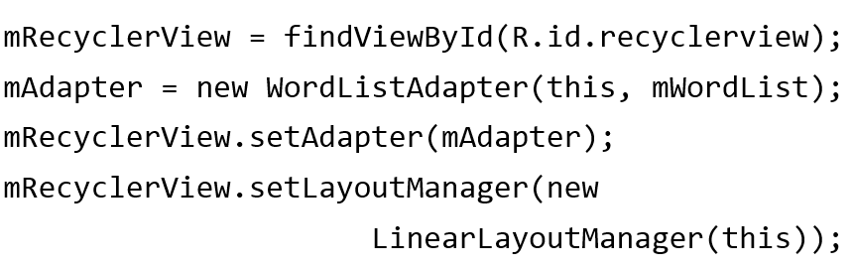
Implementation Steps
Create the RecyclerView in Activity onCreate()

Slide 20
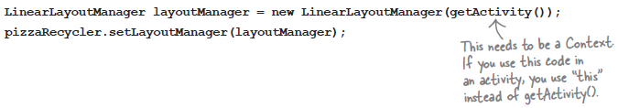
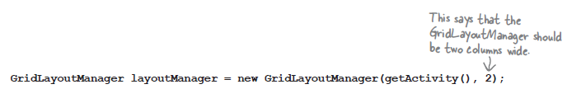
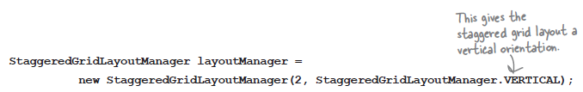
Implementation Steps
Create the RecyclerView in Activity onCreate()
Linear Layout Manager
Grid Layout Manager
Staggered grid Layout Manager

Slide 21
References
Head First Android Development. A Brain friendy guide. Dawn Griffiths and David Griffiths.O’reilly. ISBN:978-1-449-36218-8. Chapter 13
https://google-developer-training.github.io/android-developer-fundamentals-course-concepts-v2/unit-2-user-experience/lesson-4-user-interaction/4-5-c-recyclerview/4-5-c-recyclerview.html

